Slide 1
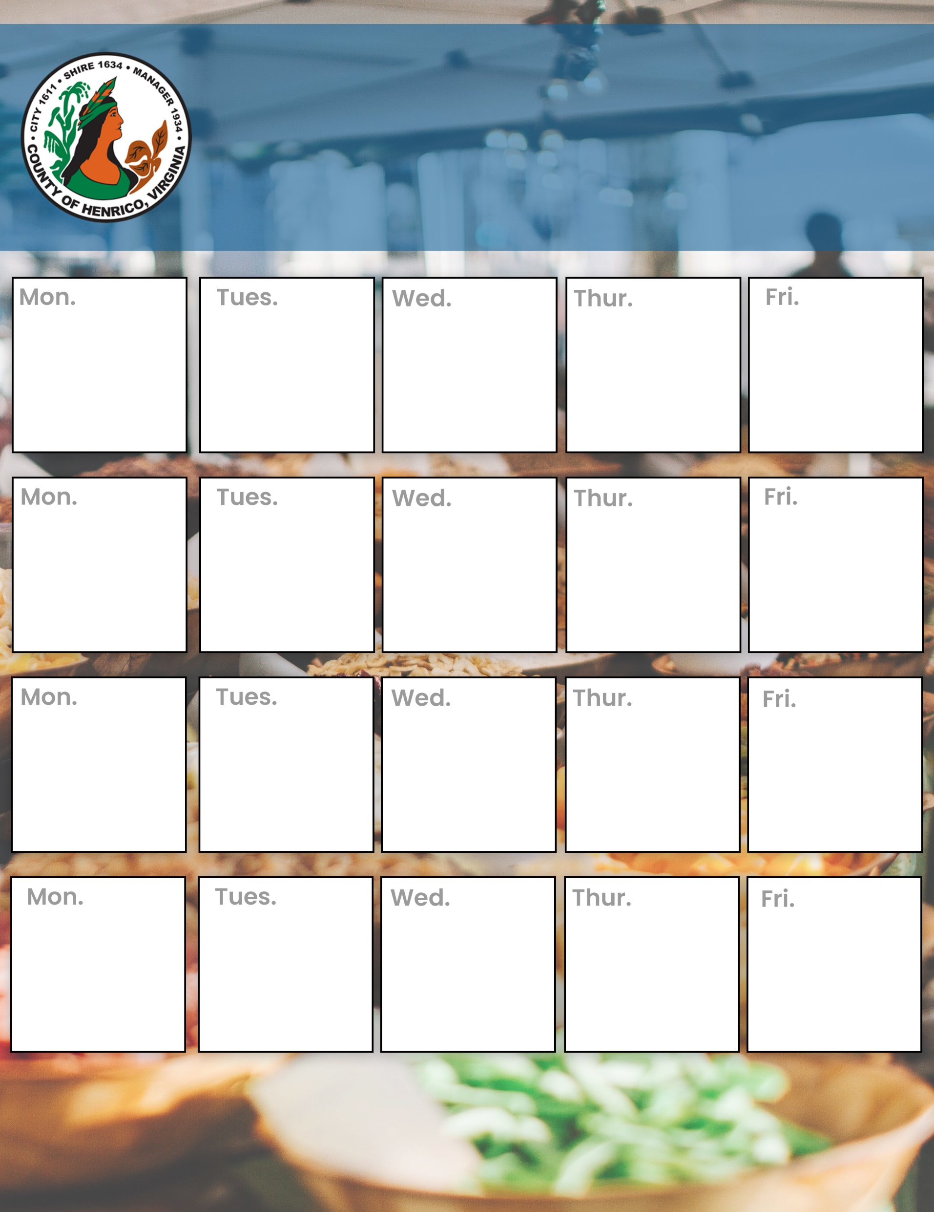
Sept - Oct 2026 Menu
Lunch Entrees $11.99
9/21/26
9/22/26
9/23/26
9/24/26
9/25/26
Jerk Chicken
Rice & Peas
w/Cabbage
Pork Carnitas Tacos
With all the fixens!
Mykonos Greek Bar,
Roasted Lamb Strips, Lemon Herb Chicken, Tzatziki & More!!!
Shrimp Po Boy
On a Hoagie w/French Fries
Turkey Melt
W/French Fries
9/28/26
9/29/26
9/30/26
10/1/26
10/2/26
Chicken Taco Salad
All your favorites in a Tortilla Bowl!!
Seared Salmon w/Burre Blanc
Over Rice Pilaf
Nashville Hot Chicken Sandwich
W/ Fries
Beef & Broccoli
Over Rice
Fried Catfish
W/Mac & Cheese and a Cornbread Muffin
10/6/26
10/7/26
10/8/26
10/9/26
10/10/26
Spaghetti & Meatballs
Homemade Marinara & Garlic Breadstick
Chicken Lo Mein
Asian Vegetables and so much more!!!
Red Beans and Rice
Cornbread Muffin!!
Grandma's Tuna Melt!!!
Homemade Tuna Fish served w/Fries
Beef Enchilada
Homemade Sauce, melted cheese, and all the fixens!!
10/12/26
10/13/26
10/14/26
10/15/26
10/16/26
Alex's Louisiana Gumbo
Served over rice
Steak & Cheese Subs
Served on a Hoagie w/White American and Fries
Meat Lasagna
Homemade Sauce, Melted Cheese and Galic Bread
Beef Stroganoff
Served with Egg Noodles and Russian Mushroom Cream Sauce
Chili Con Carne
Homemade Chili in a Bread Bowl!!!

